Slide 1
INTRO TO WEB APPS
https://github.com/tnt-summer-academy/Curriculum-2022/wiki

Slide 2
Learning Objectives
TNTs will learn the basics of how web pages and web apps work.
TNTs will be able to make HTML and CSS changes and know about JavaScript.
TNTs will learn where to go for CSS and HTML info and resources.

Slide 3
PART 1 BACKGROUND AND OVERVIEW
15 minutes

Slide 4
Web sites versus Web apps versus Native apps
Website - informational, can be static or dynamic, access with a URL
Web app - interactive, user control, saves data, often sign-in, access with a URL or downloaded in an app store
Native apps - specific to an operating system and work just on that platform - iOS (Swift, Objective C), Android (Kotlin, Java), Windows (C#). Is downloaded in an App Store
Notes:
Incorporate gestures, notifications etc.

Slide 5
Comparing Native apps with Web apps
Native Apps | Web apps
Specific operating system | Internet browser
Install from app store, download, online/offline | URL or install from app store, download, if url, online
Programming languages (Swift, Kotlin, Java, C#) | Languages of the web (HTML, CSS, JavaScript, frameworks, libraries)
One version per platform | Multiplatform
Native UI | UI of the web
Broad access to hardware features | Delayed access to hardware features
Performance optimized for target platform | Performance optimized for browser

Slide 6
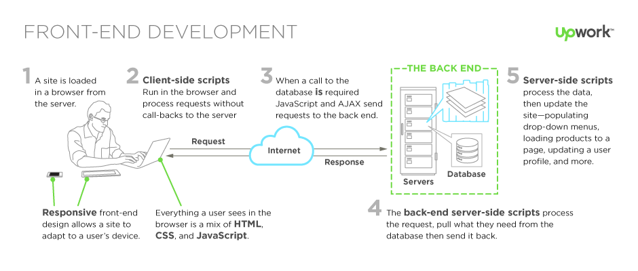
How a full-stack web apps work?

Slide 7
PART 2 WEB TECH
10 minutes

Slide 8
Prototype
Optional

Slide 9
Why will you build a web app prototype?
Quicker to prototype
Introduction to broadly applicable tech - VS Code, HTML, CSS, JavaScript
Many projects - professional, community, philanthropic, for fun...
Differences of capabilities between web and native apps are closing
PROTOTYPE

Slide 10
What technologies are we focusing on?
Technology / Tooling | Solution
Markup / Styling / Programming Languages | HTML, CSS, JavaScript
Web framework | React
Project setup | React create app tool
Server environment | Node.js, npm
Source control | Git, GitHub
Source control tools | Command line, VS Code
Testing infrastructure | Jest
Component library | Bootstrap
Databases | Firebase

Slide 11
HTML, CSS and JavaScript
How are they working together?
Hyper Text Markup Language (HTML) - the language for building webpages
Cascading Style Sheets (CSS) - the language for styling webpages
JavaScript (JS) - the language for programming web pages
Notes:
Separation

Slide 12
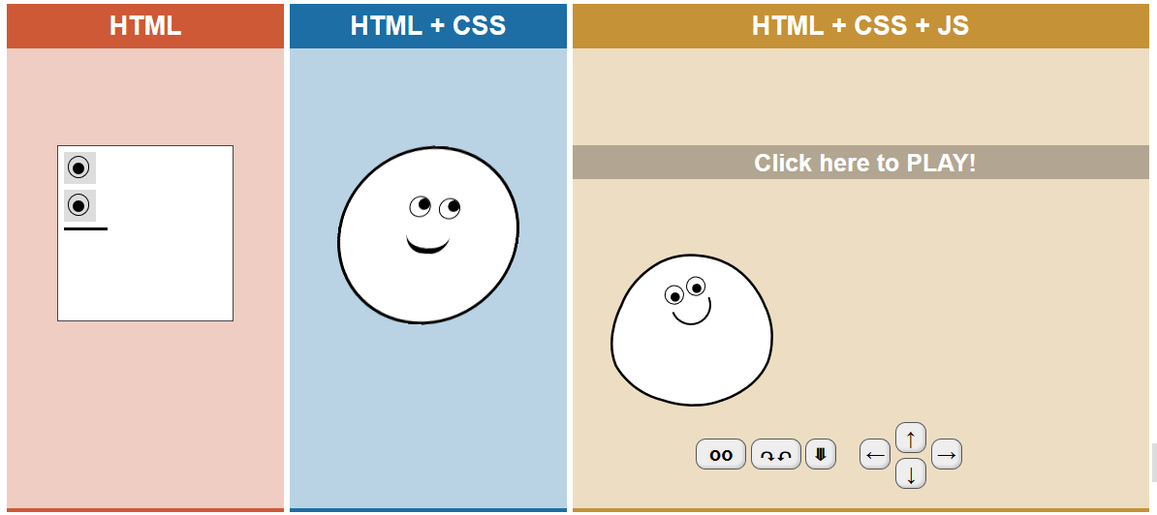
https://html-css-js.com

Slide 13
HTML https://htmlcheatsheet.com
HTML = Hyper Text Markup Language
Language based on tags and rendered by a browser
Files with html extension
index.html is the entry file in a web site
Skeleton of an HTML page
<html>
<head>
<title>
…
</title>
</head>
<body>
…
</body>
</html>
Tags
<p> … </p> - paragraph
<em> … </em> - italic
<b> … </b> - bold
<h1> … </h1> - level of title
(from 1 to 6)
<img src = …> - image
<a href = > … </a> - link
<br /> - blank line
<ul> - list
<li> … </li>
<li> … </li>
</ul>
<div> … </div>
Open tag
Close tag

Slide 14
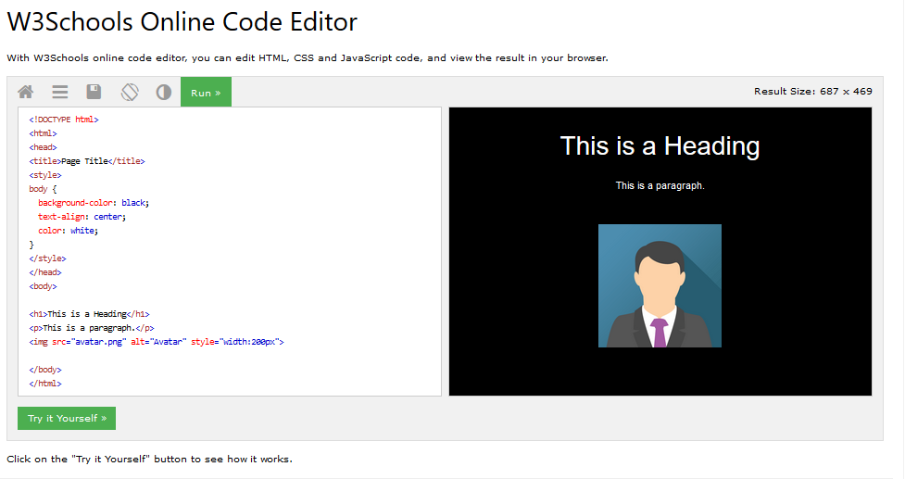
If you need practice https://www.w3schools.com/tryit
https://www.w3schools.com/tryit/
Notes:
https://htmlcolorcodes.com/

Slide 15
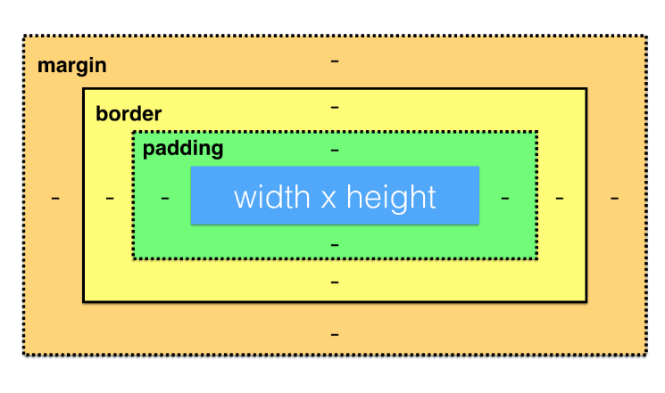
CSS https://htmlcheatsheet.com/css
CSS = Cascading Style Sheets
For the visual presentation of an HTML document (text color, size, style, layout, gradients, opacity etc)
Files with css extension
Integrate CSS:
Inline
<style type="text/css"> body {color:red;} </style>
External file
<link rel="stylesheet" href="style.css" type="text/css">
Based on applying rules on specific elements (selectors). Rules assign values to properties

Slide 16
CSS https://htmlcheatsheet.com/css
Example 1: body {color:red; font-style:italic;}
Example 2
<h1 class="loud">Hi!</h1> <p id="low"> How are you? </p> <ul> <li class="loud">Pizza</li> <li>Soda</li> </ul> | Tag h1 {color: red;} Id #low{font-style: italic;} (ids are unique) Class .loud {font-style: bold;}

Slide 17
If you need practice https://www.w3schools.com/tryit
https://www.w3schools.com/tryit/
Notes:
https://htmlcolorcodes.com/

Slide 18
Online editors to practice
W3Schools https://www.w3schools.com/tryit/
Codepen https://codepen.io/
JSFiddle https://jsfiddle.net/

Slide 19
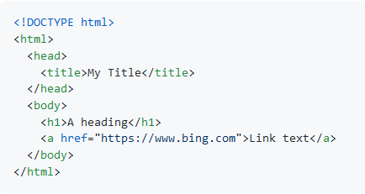
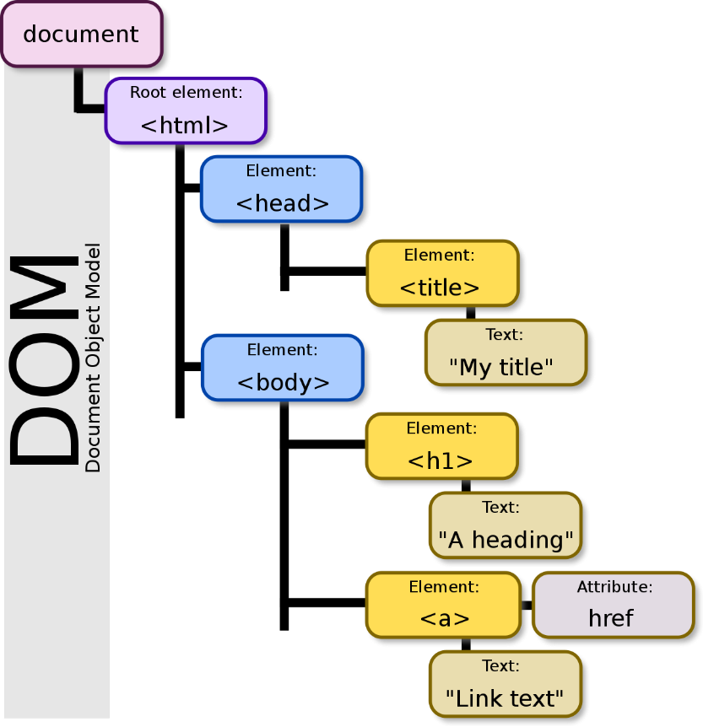

Document Object Model (DOM)
The Document Object Model (DOM) is a cross-platform and language-independent interface that treats an XML or HTML document as a tree structure wherein each node is an object representing a part of the document.
The DOM represents a document with a logical tree.
The HTML DOM can be accessed with JavaScript (and with other programming languages).
Access programmatically

Slide 20
Document Object Model (DOM)
HTML elements are defined as objects with properties and methods.
HTML DOM methods are actions you can perform (changing adding and deleting an element).
HTML DOM properties are values (of HTML Elements) that you can set or change (e.g., changing the value of an HTML element).
More about the DOM here: https://www.w3schools.com/js/js_htmldom_methods.asp
<html> <body> <p id="demo"></p> <script> document.getElementById("demo").innerHTML = "Hello World!"; </script> </body> </html>

Slide 21
PART 3 DEMO & EXPLORE
30 minutes

Slide 22
Meet Your Instructors page
Download the code and open the index.html file in a browser
https://github.com/tnt-summer-academy/Exercises/tree/main/Week_1/ENG1.0/meet-your-Instructors
What browsers do you have installed?

Slide 23
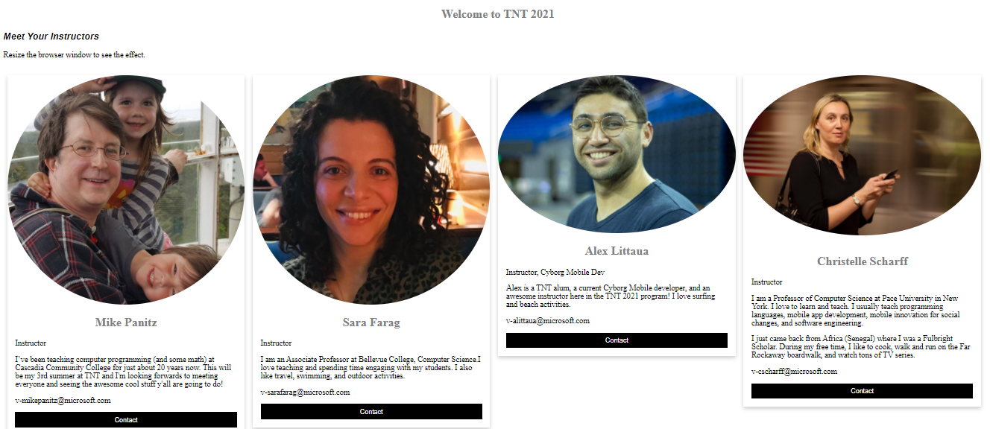
Testing on different browsers
Testing on different browsers Resize the browser window

Slide 24
Let’s look at the code
Download or clone the code
https://github.com/tnt-summer-academy/Exercises/tree/main/Week_1/ENG1.0/meet-your-Instructors
Let’s walk through the code
HTML
CSS
Use more in the terminal to look at files.
You can also use pico.
Use the browser developers' tools to make changes in the CSS file

Slide 25
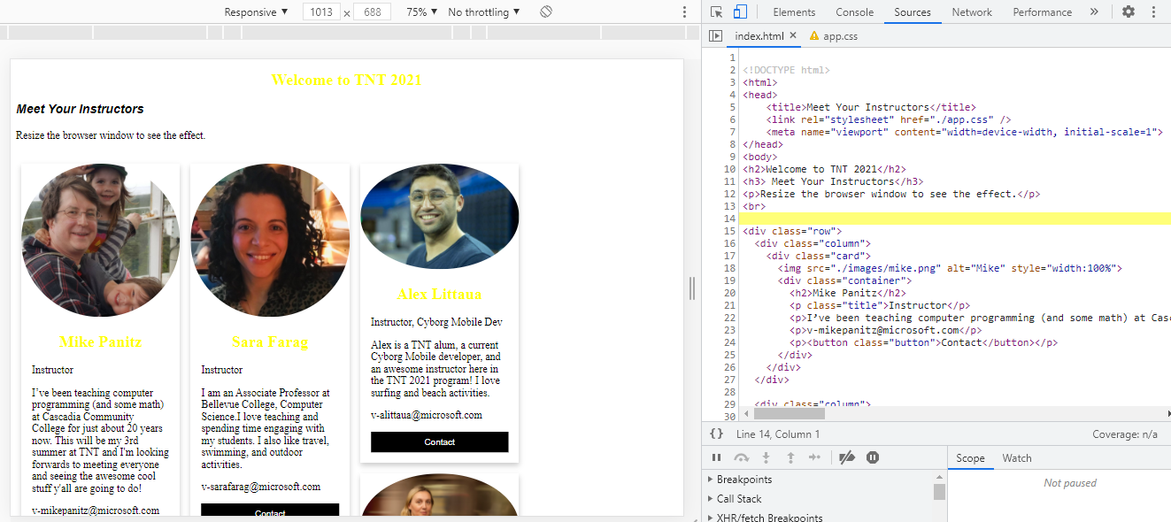
Source code

Slide 26
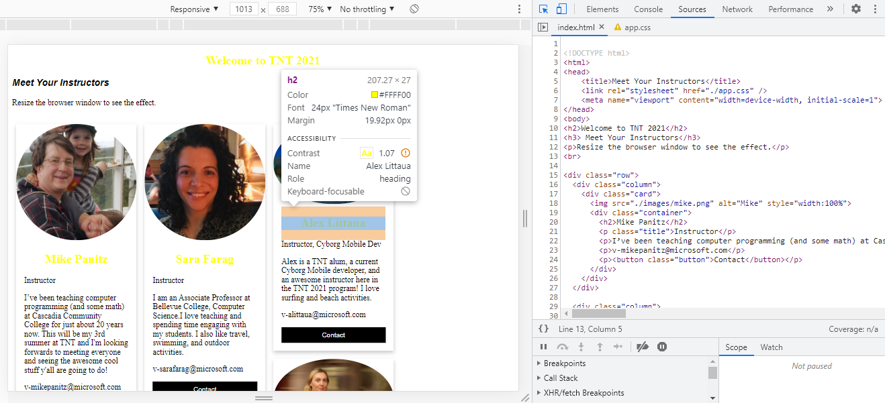
Inspection

Slide 27
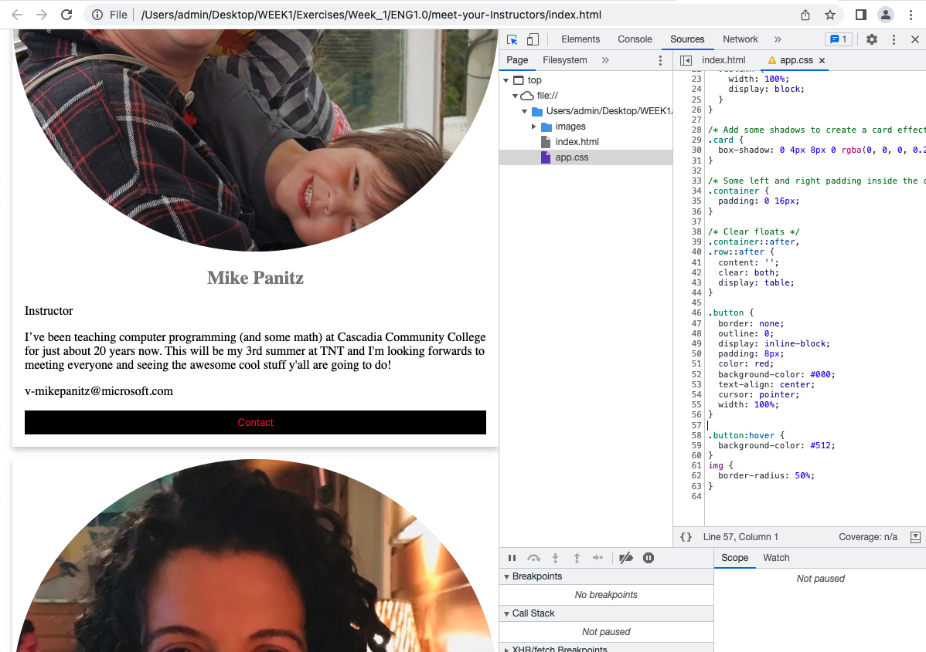
Change the CSS

Slide 28
PART 4
GROUP ACTIVITY
Remaining time

Slide 29
Important links
HTML basics https://www.w3schools.com/html/html_basic.asp
CSS intro https://www.w3schools.com/css/css_intro.asp
Go through HTML and CSS content

Slide 30
Mock-up of your favorite app
Pick one of your favorite apps on your phone.
Using the online editor try to mock, or recreate, a single screen from the app with CSS and HTML.
Post your screen in your team's Team channel.
If you finish one screen, choose another more challenging one (optional).

Slide 31
Recommended process
Pick an aspect of the screen that you'd like to try and replicate in your mockup
(for example, the title)
Start by putting the text / image / etc onto the web page without any formatting.
(for example, the title and several images)
Next, pick one aspect of that newly added thing that looks different between your phone's screen and the web page, and see if you can make the web page look closer to the app
(for example, "can I find a similar font? And how do I change the font in CSS?").
Adjust the appearance of your app.
'Close enough' is good enough.
Ability to pivot / change your goals
Not more than 5-10 minutes Repeat step 3 until you're satisfied with how the element looks.
Repeat these steps until you've add enough elements to the page that it kinda looks like your phone app's screen

Slide 32
STRETCH

Slide 33
Stretch
Find new topics in HTML and CSS to explore
Modify Meet Your Instructors
Animated 3D flip of an image instead of static tile
Add script to the button to make it clickable and show a popup alert with the contact email address
Change the page layout to use a different CSS layout

